Slide 1

Breast Cancer Diagnosis Prediction
Group 3
DAB304-24W-001: Healthcare Analytics
Dr. Sutharsan Sivagnanam

Slide 2



Team members
Nga Le
Srilakshmi Gummadidala
Tehsin Shaikh

Slide 3
OBJECTIVES OF PROJECT
Global Challenge
Machine Learning Solution
Data-Driven Predictions
Advancing Diagnostics
Notes:
Global Health Challenge:
Breast cancer's significant impact on health worldwide.
Crucial role of early and accurate diagnosis in effective treatment and patient outcomes.
Predictive Model Development:
Utilization of machine learning techniques.
Aim for enhanced precision and efficiency in breast cancer diagnostics.
Data Analysis:
Examination of a clinical case dataset.
Projected to predict tumor malignancy based on various attributes.
Contribution to Healthcare:
Advancing the field of breast cancer diagnostics.
Supporting the improvement of patient care and management strategies.

Slide 4
PROBLEM STATEMENT
Develop
Create a machine learning algorithm to discern benign from malignant breast tumors.
Analyze
Examine how each characteristic influences the prediction, identifying key diagnostic factors.
Employ
Utilize robust metrics to rigorously evaluate and confirm the model’s accuracy.
Notes:
Develop:
Build a machine learning model to predict whether a breast tumor is benign or malignant based on various attributes.
Analyze:
Analyze the impact of each attribute on the prediction to understand the key factors influencing the diagnosis.
Employ:
Evaluate and validate the model's performance using appropriate metrics.

Slide 5
DATASET OVERVIEW
Data Source
Sourced from Dr. Wolberg’s clinical cases to drive breast cancer research and diagnostic advancements.
Clinical Case Volume
Total of 699 individual instances representing unique patient cases as of July 15, 1992.
Database Structure
Tabular dataset format for ease of analysis.
No complex relational database schemas, straightforward attribute-to-case alignment.
Variable Insights
11 Attributes (10 Predictors and 1 Label)

Slide 6
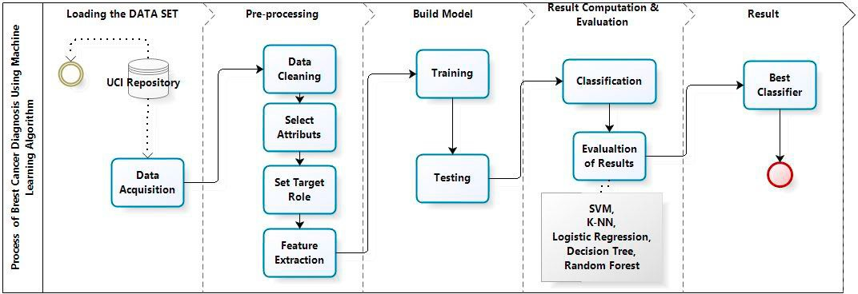
Source: https://www.sciencedirect.com/science/article/pii/S1877050921014629
METHODOLOGY
Random Forest,
Logistic Regression,
Decision Tree,
Neural Networks

Slide 7
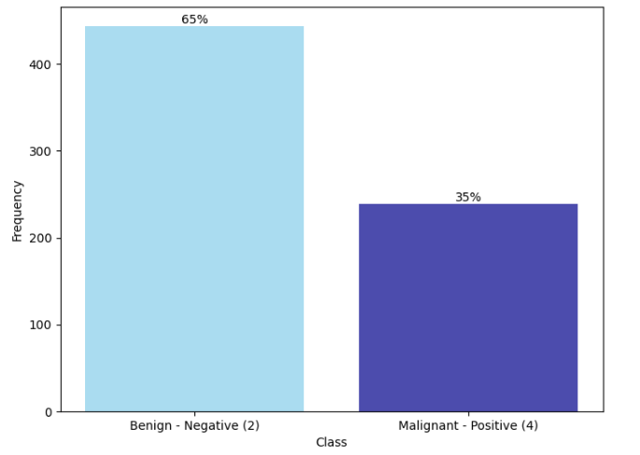
EXPLORATORY DATA ANALYSIS
Data Preprocessing
Filtering missing entries, transformed 'Bare Nuclei' to integers, and purged duplicates for unbiased analysis.
Data Visualization
Key Insight:
Benign (444, 65%) and malignant (255, 35%)
The dataset's imbalance underscores the critical need to address bias towards the more prevalent class during predictive model development.
Frequency Distribution of Class

Slide 8
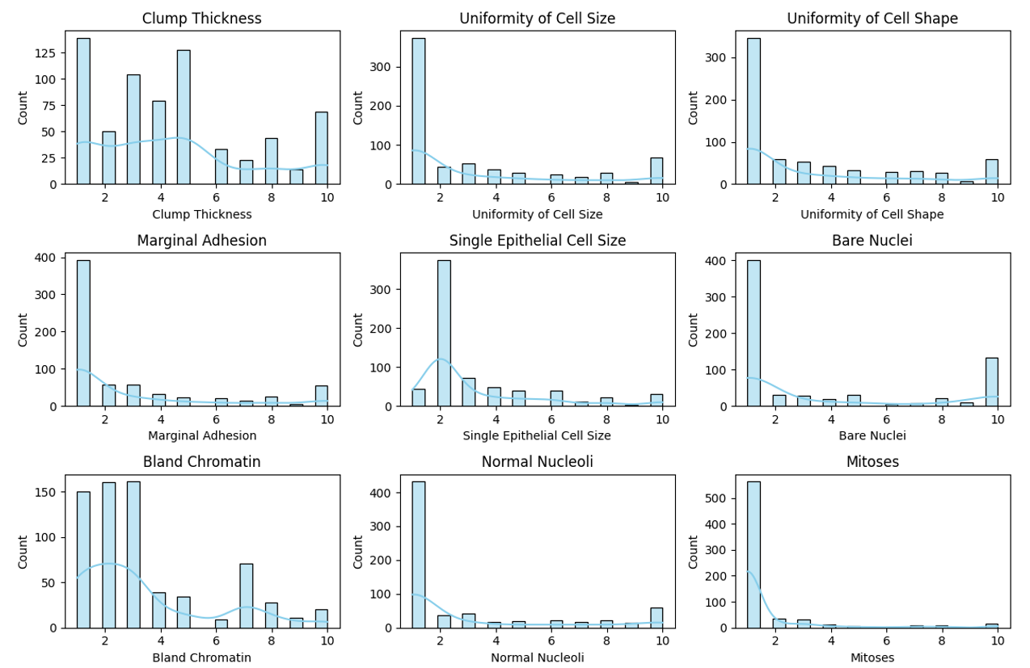
Cell uniformity
Lower uniformity in size and shape strongly associated with malignancy.
Adhesion indicator
Low marginal adhesion frequently signals cancer presence.
Risk signals
High bare nuclei counts are significant markers of elevated cancer risk.
Mitotic alerts
Sporadic high mitotic rates are important indicators of aggressive cancers.
Key Insights:
Characteristics of Features

Slide 9
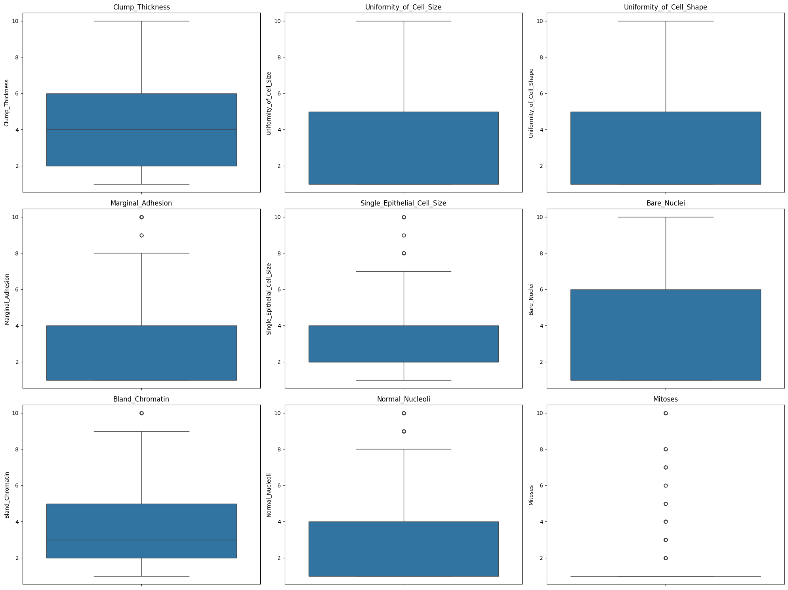
Key Insights:
Uniform Cell Behavior
Predominantly consistent patterns across key cell features.
Critical Outliers
Sparse but pivotal, these outliers flag potential cell anomalies.
Uniformity Trend
Cell size and shape suggest a normative uniformity within the sample.
Detecting Malignancy
Noteworthy outliers in adhesion, cell size, and mitosis serve as red flags for cancer detection.
Outlier Detection & Data Spread Analysis

Slide 10
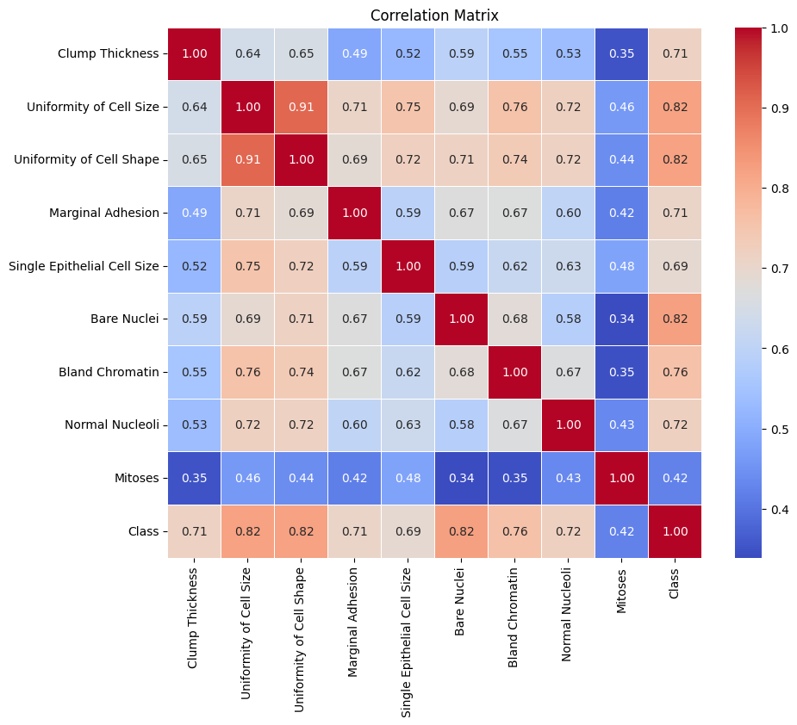
Key Insights:
Predictive Correlation
Cell uniformity in size and shape is closely linked to malignancy.
Diagnostic Indicators
High counts of bare nuclei are strong predictors of cancerous tissues.
Focused Strategy
These correlations guide the development of targeted diagnostic approaches.
Correlation Matrix

Slide 11
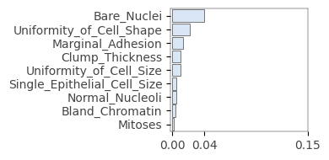
Key Insights:
Feature Ranking
Chart prioritizes features based on the predictive model's assessment.
Influential Factors
Highlights critical variables for enhancing prediction precision.
Biological Insight
Offers a deeper understanding of tumor malignancy biology.
Feature Importance

Slide 12
Model Comparison & Best Model Evaluation
Data Modeling
Classifiers performances
Comparative graph of different classifiers
TOP PERFORMER = Logistic Regression
LOGISTIC REGRESSION
Notes:
Model Comparison & Best Model Evaluation
Classifiers Performance
Comparative graph of different classifiers

Slide 13
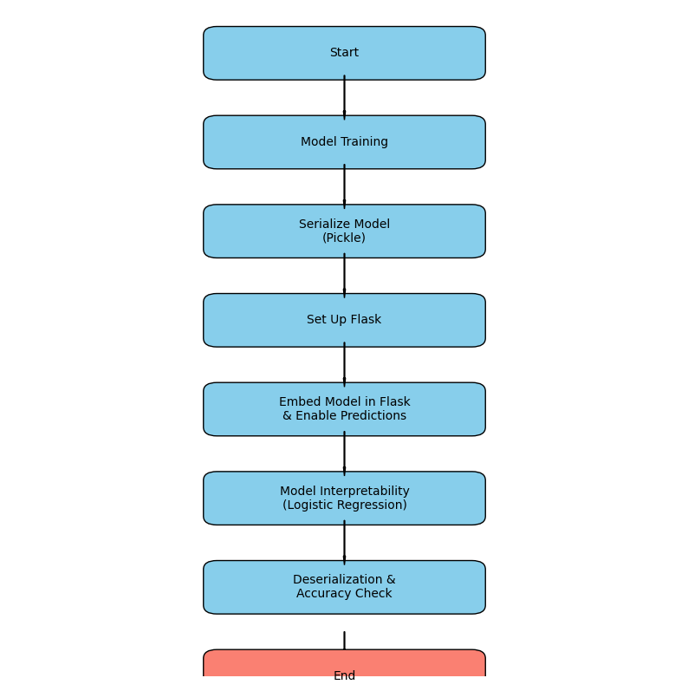
Model Deployment
End
Notes:
Deployment Process:
Start: The starting point of the process.
Model Training: Before deployment, there is an implicit step where the model must be trained.
Serialize Model: Using Python's pickle module to serialize the trained breast cancer classification model to disk.
Set Up Flask: Prepare a Flask web hosting environment.
Embed Model in Flask: Integrate the serialized model into the Flask app.
Model Prediction: Enable users to predict breast cancer likelihood through the Flask app.
Model Interpretability: Utilize logistic regression for better interpretability and computational efficiency.
Deserialization: When needed, deserialize the model for prediction in production environments.
Accuracy and Scalability: Ensure that the model maintains accuracy and is scalable.
Deployment for Adoption: Deploy the model for widespread adoption.
Healthcare Advancement: Contribute to breast cancer diagnosis and treatment advancements.
End: The end of the process.

Slide 14
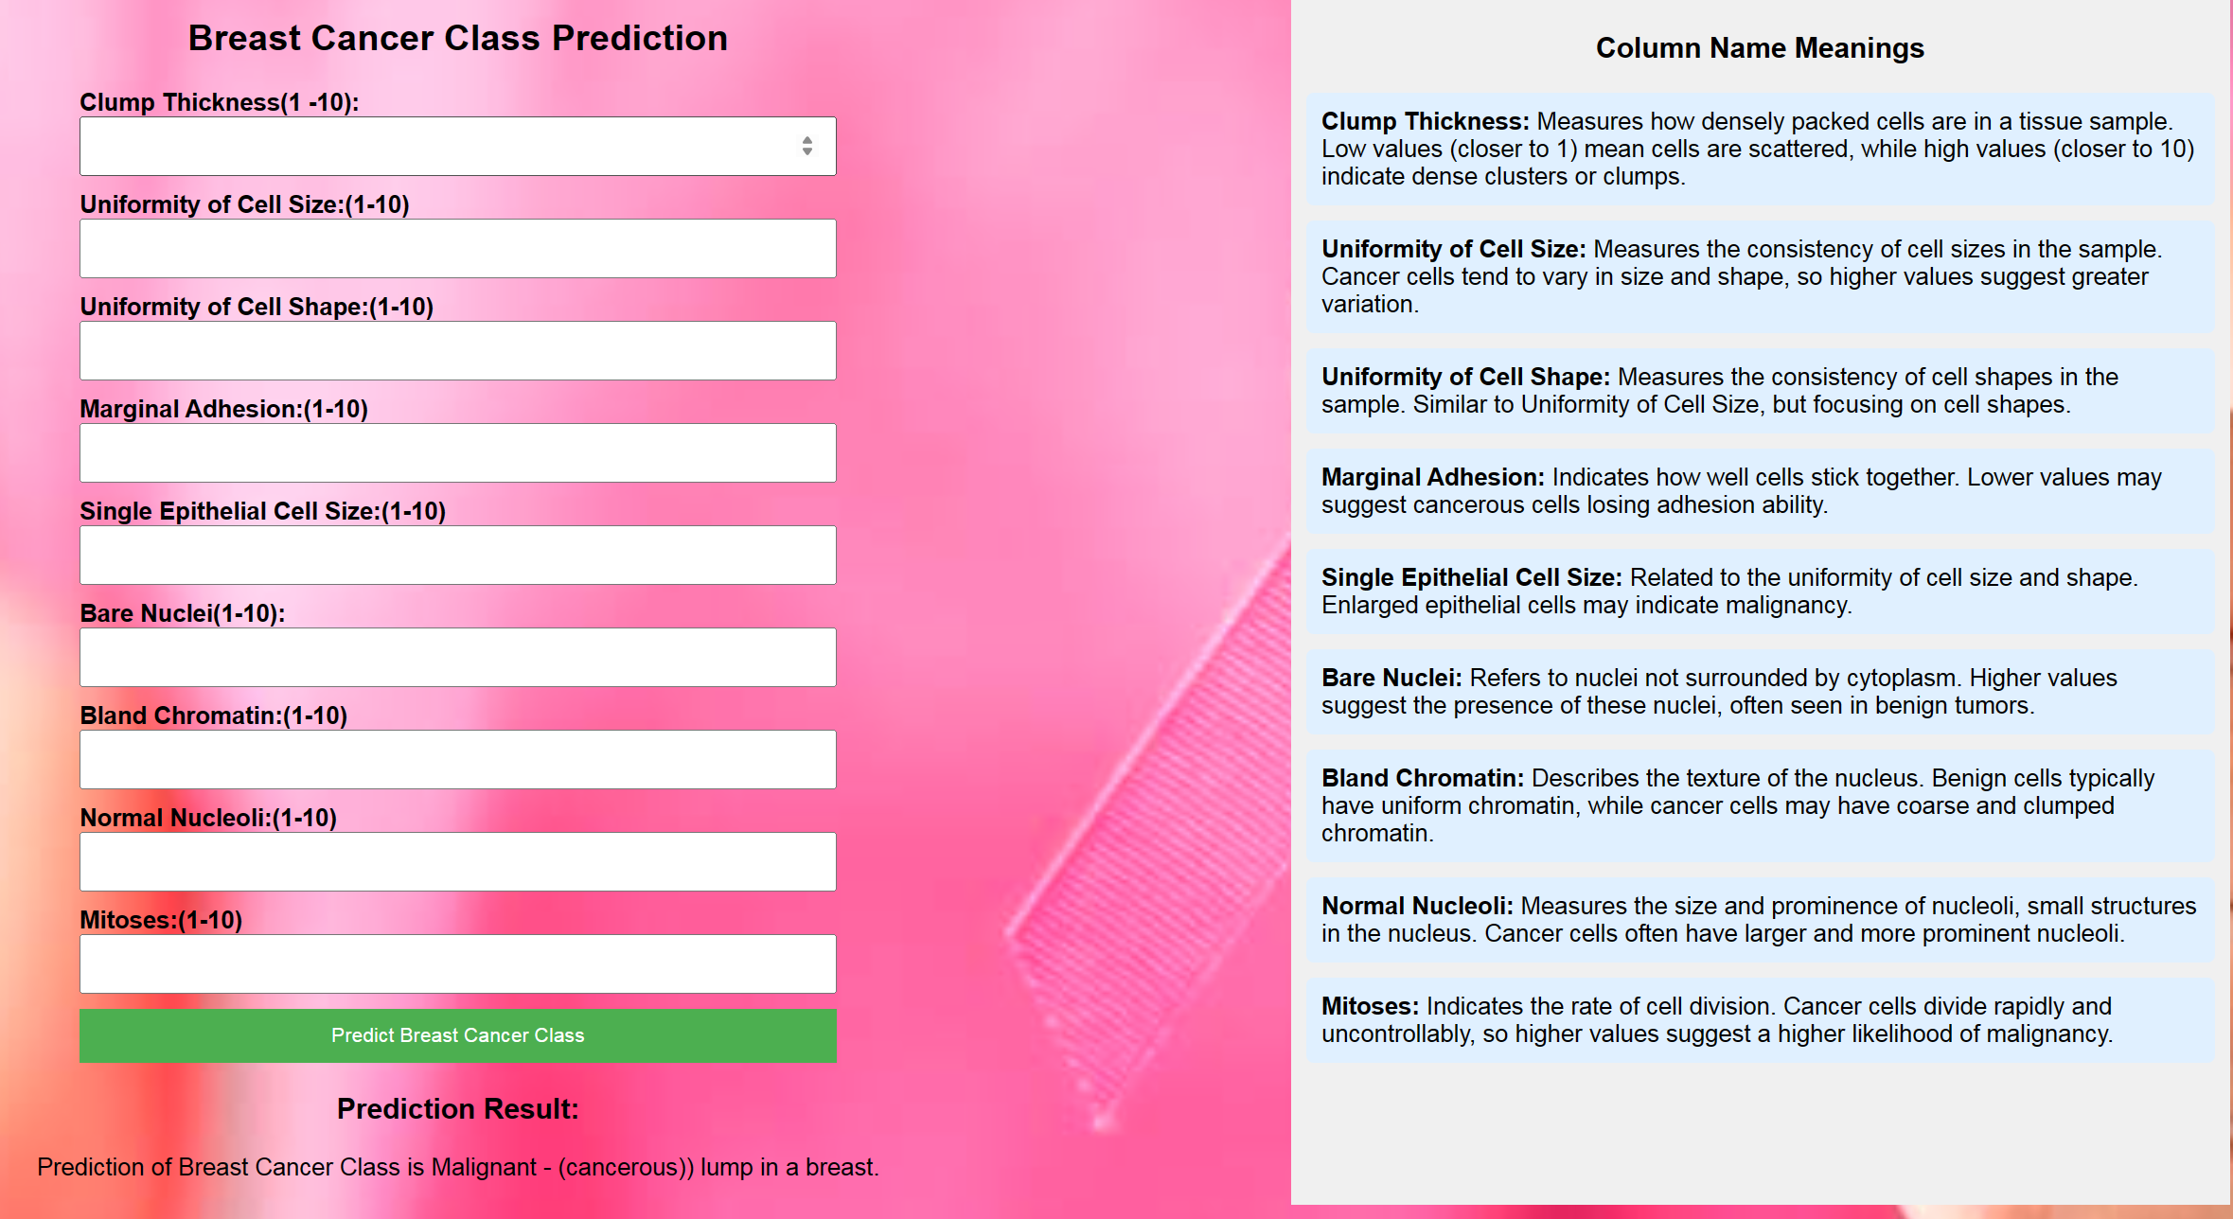
Model Deployment – Demo & Outcomes
Notes:
Show the demo

Slide 15
CONCLUSION
Machine Learning Milestone
Precision diagnostics via state-of-the-art algorithms, accurately separating benign from malignant growths.
Enhancing Practice
Facilitating earlier detection, sharpening tumor analysis, bolstering patient care.
Synergetic Collaboration
Merging expertise from multiple disciplines, refining decision-making, solidifying model efficacy.
Advancing Medicine
Charting the future of breast cancer diagnosis, underlining the pivotal role of tech innovation in health.
Notes:
Machine Learning: Powering a Diagnostic Revolution
Leveraging cutting-edge algorithms for precision diagnosis
High accuracy in distinguishing between benign and malignant tumors
Empowering Medical Practitioners
Enabling early detection for improved patient outcomes
Deepening insights into tumor malignancy factors
Collaboration: The Catalyst for Success
Uniting data scientists, clinicians, and researchers for synergy
Enhancing clinical decision-making through robust models
Pioneering Precision Medicine
Propelling breast cancer diagnostics into a new era
Demonstrating technology's transformative impact on healthcare make it skew without losing the meaning

Slide 16
"Technology gives us the power to turn cancer patients into cancer survivors.”
Thank you!

